Slide 1
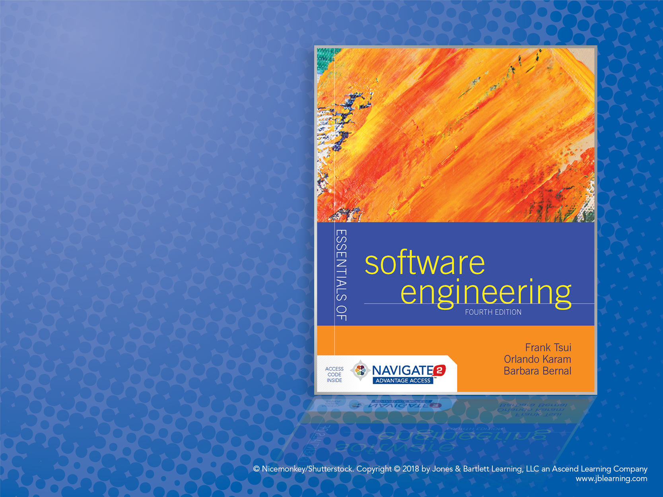
Chapter 1:
Creating a Program

Slide 2
Introduction to Creating a Program
We all “start” by learning how to code in some programming language.
With a small, hypothetical, and fairly well-defined problem.
Usually the code is within one module.
We then learn that the program usually does not work on the first try, second try — may be even 5th or 6th try!
We learn about “testing” the program.
We learn about re-reading and re-thinking the (problem) requirements more carefully — then find that we may not have all the answers.
We learn about tracing and “debugging” the program.
Then — somehow magically — we decide that it’s “good enough !”
Perhaps
Not
in
This
Order
This is a common (popular) developer’s “simple-reflex” approach.

Slide 3
Considerations and Decisions
Problem Statement
“Given a collection of lines of text (strings) stored in a file, sort them in alphabetical order, and write them to another file.”
What Are the Program Requirements?
Input formats? Sorting?
Special cases, boundaries, and error conditions?
Performance? Real time? Security?
What Are the Design Constraints?
User interface? Typical and maximum input sizes?
Platforms? Schedule?

Slide 4
More to Consider and Decide on
Testing Time
While program is defined
While program is developed
After program is completed
Kinds of Tests
Acceptance (validation)
Verification
Unit testing
Black box
White box

Slide 5
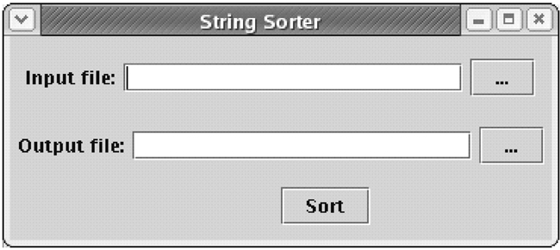
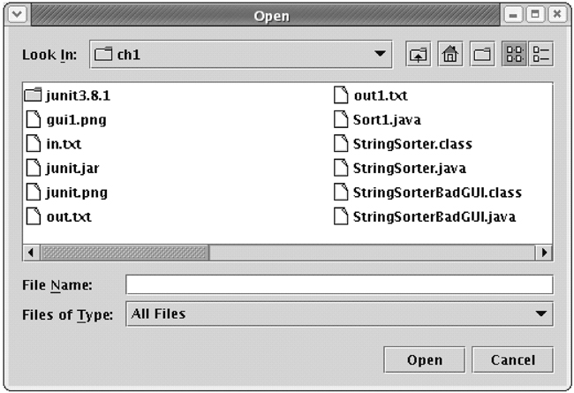
Version 1. Estimate Total Minutes
Write a program that reads lines from one file and writes the sorted lines to another file. Assume that you will be writing the sort routine yourself and will implement a simple GUI (first image).
Pressing one of the two buttons displays a File Open dialog (second image), where the user can navigate the computer’s file system and choose a file.
Assume that you can work only on this one task, with no interruptions. Provide an estimate within 1 minute.
Step 1. Estimated ideal total time: _________________

Slide 6
Version 2. Estimated Calendar Time
Is the assumption that you will be able to work straight through on this task with no interruptions realistic?
Won’t you need to go to the restroom or drink some water?
Can you spend the time needed on this task?
If you were asked to do this task as soon as reasonably possible, starting right now, can you estimate when you would be finished?
Given you start now, estimate when you think you will have this program done to hand over to the client. Also give an estimation of the time you will not be on task (for example: eating, sleeping, other courses, etc.).
Step 2. Estimated calendar time started: ____________ ended:___________ breaks:______________

Slide 7
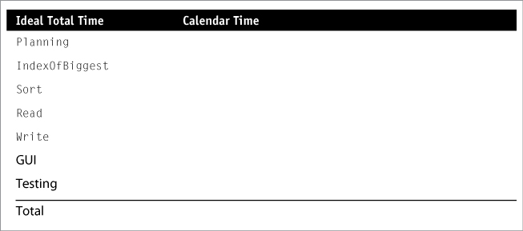
Version 3. Estimation of Subtasks
Divide the entire program into separate developmental tasks; these tasks might be divided into several subtasks.
Your current task is a planning task, which has estimation as a subtask.
When thinking of the requirements for the project, assume you will create a class, called StringSorter, with three public methods: Read, Write, and Sort.
For the sorting routine, assume that your algorithm involves finding the largest element, putting it at the end of the array, and then sorting the rest of the array using the same mechanism. Assume you will create a method called IndexOfBiggest that returns the index of the biggest element on the array.

Slide 8
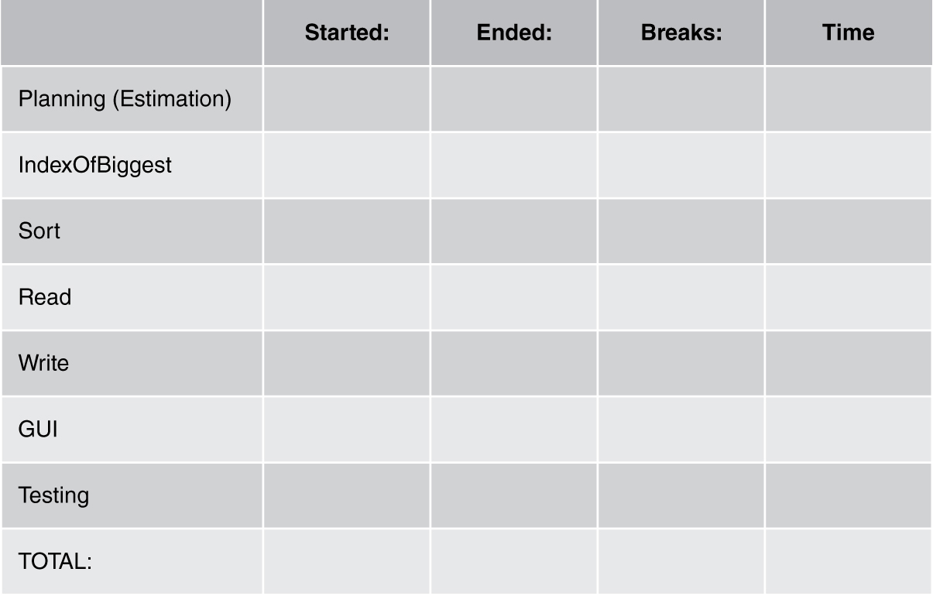
Actual Time Creating the Program
Now design and implement your solution while keeping track of the time.

Slide 9
A “Simple” Set of Steps
1) Understand the problem – requirements
Functionalities
Non-functionalities: performance, security, modifiability, marketability, etc.
2) Perform some design – based on requirements
Organize the functionalities in some sequence; possibly using some diagrams.
Focus on input/output (data, formats, organization).
Think about some constraints (non-functionalities) such as speed, UI looks, programming language, dependencies, etc.
Any specific algorithm and improvements on sequence of functionalities.

Slide 10
A “Simple” Set of Steps (cont.)
3) Code/Implement – turning the design into actual code
Depending on how much design is completed, one may either directly engage in conversion to code (language dependent) or do some more designing.
A) Convert input/output to specific UI interface or I/O format.
B) Sequence the processing in the desired order.
C) Ensure and convert the processing “algorithm” correctly to the target language construct.
D) Figure out how to use language library (properly).

Slide 11
A “Simple” Set of Steps (cont.)
4) Verify/Test the program – check the program results (via output) with some predetermined expected set of inputs.
The pre-determined inputs are “test cases” and require some thinking.
If the results do not match what is expected then:
“Debug”
Fix
Retest — reverify
Stop when all test cases produce the expected results.
Question: How many test cases should we develop and run?

Slide 12
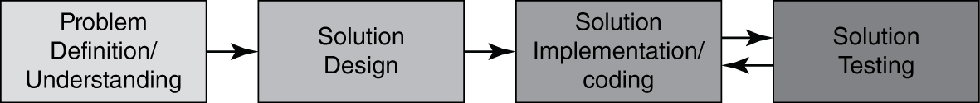
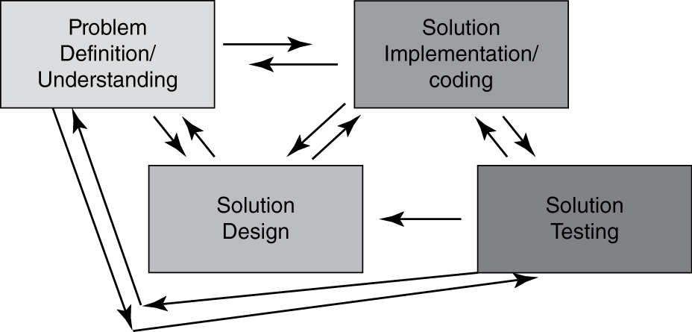
What Really Happens?
“Imagined” – Ideal Situation
“Actual” – Happening

Slide 13
Code Is “Done”! What Else Matters?
How long (elapsed time) did it take to complete the work?
How much effort (total person hours) is expended to do the work?
Does the solution solve the complete problem?
How “good” is the work — (code, design, documentation, testing, etc.)?
based on?

Slide 14
Consider a “Simple” Problem
Write a “program” in your favorite language that will accept numerical numbers as inputs, compute the average, and output the answer.
Answer these questions in class:
How long (in elapsed time) would it take you to implement this solution?
How much overall effort (in person hours) will this take?
How well will your solution match the problem?
How good is your code/design/documentation/testing?

Slide 15
Past Class Answers
How long (in elapsed time) would it take you to implement this solution?
Class Answer: 10 min. (Greg); 15 min. (Frankie); 1 hour (Mark)
How much overall effort (in person hours) will this take?
Class Answer: 10 person min.; 15 person min.; 1 person hour;
3 person hours
Will your solution match the problem?
Class Answer: YES!
How “good” will your solution be?
Class Answer: Awesome!
Let’s see how your “real” individual data come out.

Slide 16
Some “Previous Class” Inputs
How long do you think assignment #1 would take?
1 hr — 7 people
2 hrs — 6 people
3 hrs — 2 people
10 hrs — 3 people
Real data from class:
Elapsed time: range was 5 days to 46 minutes — mostly between 1 to 3 hours.
Effort: range was 8 person hours to 40 person minutes — mostly between 1 person hour to 3 person hours.

